Slide 1
Professional Learning in BASD
Curriculum Committee Meeting
August 23, 2016

Slide 2
Boyertown Area School District
An institution of learning
We wish to model lifelong learning for our students
Notes:
This represents our emphasis on learning for all – students, teachers, paraprofessionals, administrators

Slide 3
Time is Valuable
The cost of ineffective professional learning is easily calculated…
…just add up the daily salary of everyone involved…
…and then the resources used!

Slide 4
BASD Priority Areas
Effective and Continuous Learning for All District Personnel
  Transform professional learning focused on growth for all personnel to ensure engagement, relevance and rigor
  Cultivate a positive culture of instructional coaching to implement best practices
  Strengthen educators’ integrated technology skills to reach all learners
  Be an employer of choice to attract highly qualified, diverse personnel

Slide 5
Learning Needs of All Staff
Considerations
  District strategic goals, challenges, new systems that we are putting in place, new or existing laws that require staff training, new technology
  Alignment to district priorities
  Delivery of professional learning – Who are the experts?
  Feedback on sessions

Slide 6
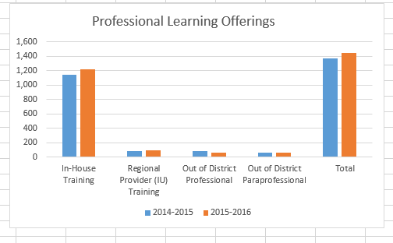
Professional Learning Data
Notes:
Represents a 5% increase in offerings from 2014-15 to 15-16;

Slide 7
Effective and Continuous Learning for All District Personnel
Transform professional learning focused on growth for all personnel
  Work of Professional Education Council and Office of Teaching and Learning

Slide 8
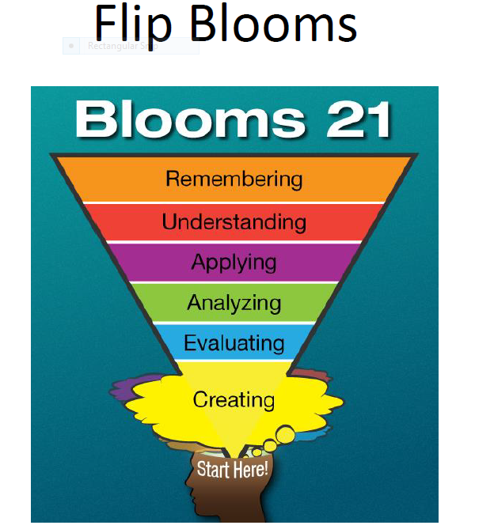
Professional Learning

Slide 9
Professional Education Council
Membership
Goal
  To revolutionize professional learning in BASD to encourage individualized, targeted, on-going opportunities to collaboratively build capacity that increases student achievement
Notes:
PEC – members made up of representatives from each of the ten schools within the district;
Teachers, administrators, coaches,
Meet quarterly –
PEC Retreat 2016 – identified teacher agency – agents of change – are we doing enough to utilize their power in making our organization more innovative?
How can we create a system that more effectively uses the voice of teachers to drive change/build capacity?

Slide 10
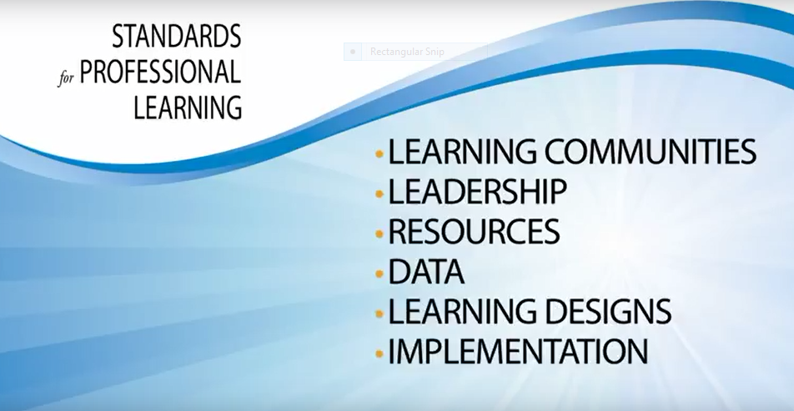
Standards for Professional Learning

Slide 11
Standards for Professional Learning
Focus on one critical aspect of the education system – professional learning
Educators taking an active role in their continuous improvement and places emphasis on the learning
  Concentrate our efforts on assuring that learning for educators leads to learning for students
Notes:
For too long, practices associated with professional development have treated educators as individual, passive recipients of information, and school systems have expected little or no change in practice
The earlier form of PD have been episodic and unconnected to a shared, systemwide purpose. Has consumed tremendous resources over the last decade and produced inadequate results for both educators and students.

Slide 12
Standards for Professional Learning
When fully implemented, educators are active partners in determining:
  the focus of their learning
  how their learning occurs
  How they evaluate its effectiveness
For most educators, professional learning is the singular most accessible means they have to develop the new knowledge, skills, and practices necessary to better meet students’ learning needs.
Notes:
Educators are part of a team, a school, and a school system that conceive, implement and evaluate carefully aligned professional learning that responds to individual, team, schoolwide and systemwide goals for student achievement

Slide 13
Standards Assessment Inventory (SAI)
SAI helps ensure professional learning increases teaching effectiveness and gets results for educators and students
Web-enabled survey that assesses the alignment of a system's professional learning practices with the Standards for Professional Learning
Notes:
school systems use this valid and reliable tool to measure teacher perceptions of professional learning, and to guide the planning, facilitation, implementation, and evaluation of professional learning to maximize its impact and investment.
Will be administered two times during the school year to teachers

Slide 14
Standards Assessment Inventory
The SAI will help our district:
  Determine your system's alignment of professional learning to the standards;
  Collect data on the quality of professional learning as defined by the Standards for Professional Learning;
  Discover teachers' perceptions of professional learning;
  Understand the degree of success and challenges you face with professional learning practices; and
  Examine the relationship of the standards to your improvements in educator effectiveness and student achievement.

Slide 15
Standards Assessment Inventory (SAI)
How will we use the data collected?
  Data analysis will be conducted by members of the Professional Education Council (PEC), Office of Teaching and Learning, instructional coaches, and Lead Teachers
  The information will guide the refinement of the BASD professional learning system

Slide 16
Effective and Continuous Learning for All District Personnel
Instructional Coaching
  What is an instructional coach?
    An instructional coach is someone whose chief professional responsibility is to bring evidence-based practices into classrooms by working with teachers and other school leaders

Slide 17
Instructional Coaching
Coaching is an established professional practice.
Coaching is one-on-one and small group professional development.
Coaching is high-quality professional development.
Notes:
Many professions ensure that their practitioners benefit from the wise counsel and hands-on assistance of experienced colleagues — in other words, coaches. Some professions require coaching as an essential part of mastering the requisite skills. In medicine, for example, internships and residencies provide required coaching for doctors new to the profession or specialty. In the legal profession, senior partners mentor junior associates. The education profession is now adopting coaching as a promising strategy for building teacher expertise, raising student achievement, and advancing school reform.
At its core, instructional coaching involves two people: the classroom teacher and the coach. Coaches work one-on-one and in small groups with teachers, providing guidance, training, and other resources as needed. Together, they focus on practical strategies for engaging students and improving their learning. Coaches also are often responsible for providing or arranging professional development activities for all teachers in a school or district.
Instructional coaching reflects the growing consensus about what constitutes high-quality professional development for teachers. It is job-embedded, addressing issues teachers face daily in their classrooms. It is ongoing, not a one-shot workshop. It is aligned to state standards, curriculum, and assessment. And its goal is twofold: improved instructional practice and improved student learning.

Slide 18
Instructional Coaching in BASD
Two instructional technology coaches
4.5 instructional coaches
  2.5 elementary
  1.0 junior high
  1.0 high school
Notes:
Coaches receive support from OTL, BCIU Coaching Collaborative, PIIC statewide mentorship program, virtual networks across the country (Twitter, weekly ed chats), local conferences in literacy/instruction

Slide 19
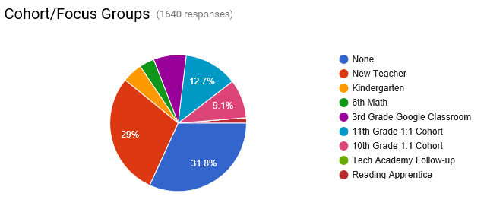
Instructional Coaching Data

Slide 20
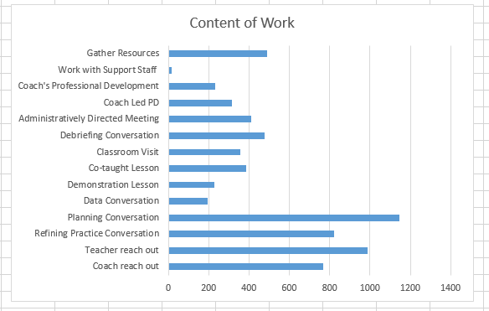
Instructional Coaching

Slide 21
Feedback from Summer Sessions
“Great session Melissa!!! Once again you've proven your wisdom as our coach! You have allowed me to look at writing in a new light and have sparked my excitement about the great lessons I can share with my students for the coming year and beyond in writing!!!”
“This was an excellent PD session! Becca and Dana did a great job at designing a very friendly and engaging workshop! I'm looking forward to applying the things I learned today in my classroom next year!”
“Loved the flexibility of Jen and Christine. They helped us to move in the direction we need to go for successful reading and writing workshop. We needed a little more time to get things done, but I really appreciate their guidance!”
“An extremely useful and well planned training! A lot of valuable information that I cannot wait to take back to the classroom!! Thank you so much for showing us how to incorporate Makerspaces into the classroom.”

Slide 22
New Teacher Academy
Quotations from new teachers:
  “To be honest, I was a little nervous about New Teacher Academy but it turned out to be incredibly useful and helpful.”
  “Thank you for providing this. It makes starting in a new district so much easier. It is planned to give the teacher some tools to start with while they are overwhelmed with basic learning of the new position. It also gets your mind on track and a great forum to share ideas for the new year.”
  “As a new teacher, I think this week was very informative with the policies and procedures within the district.”
  “Thank you so much for this week. While I am exhausted and looking forward to sleeping tonight, it did alleviate some of the stress of starting somewhere new and answered a lot of the questions I had coming to BASD. Neither of the other two places I have taught have provided such an inclusive overview of what to expect.”
Notes:
Makes our district unique
Over a decade – negotiated with the association to incorporate 15 days of professional learning for all new contracted teachers above and beyond the traditional contractual teacher requirements;
This demonstrates the support of both the association and district to provide meaningful professional learning opportunities for our staff to acclimate them to BASD

Slide 23
1:1 Laptop Cohort
2014/15 - 10th Grade Teachers
2015/16 - 11th Grade Teachers
2016/17 - 9th and 12th Grade Teachers

Slide 24
1:1 Laptop Cohort Professional Learning
Creativity
Collaboration
Critical Thinking
Communication
Notes:
Interactive, group sessions that highlight the 4 C’s and how technology can support each skill.
Students will..
Communication - Sharing thoughts, questions, ideas, and solutions
Collaboration - Working together to reach a goal — putting talent, expertise, and smarts to work
Critical Thinking - Looking at problems in a new way, linking learning across subjects & disciplines
Creativity -Trying new approaches to get things done that promots innovation & invention

Slide 25
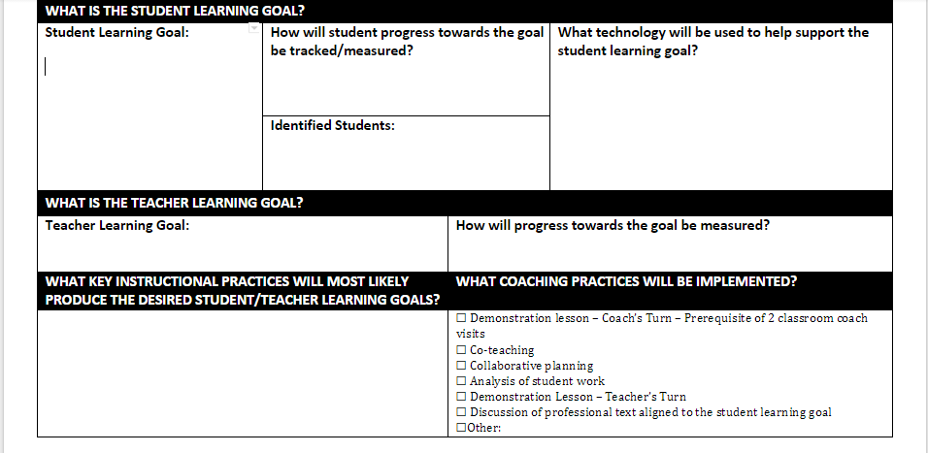
Notes:
Systematic Instructional Technology Coaching - begins with a goal that is centered around the student. We have a conversation about instructional design - how will the teacher help students reach the goal?

Slide 26
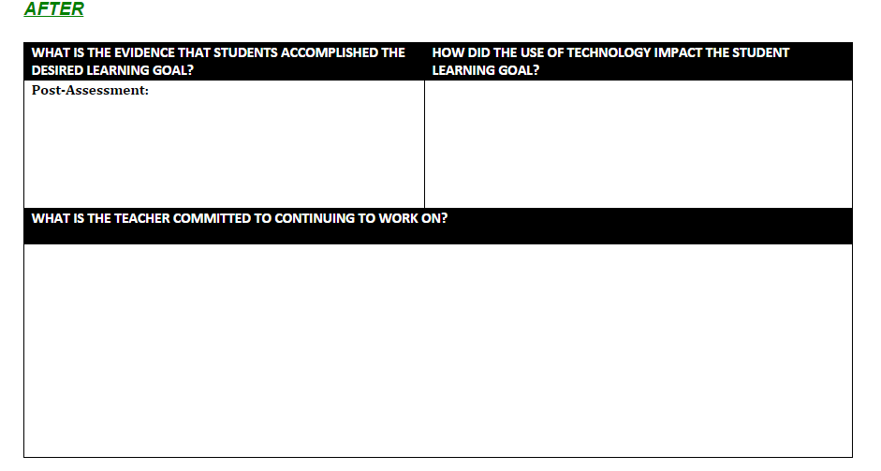
Notes:
Teacher and coach reflect and use student evidence to determine if the goal has been met.

Slide 27
Innovation Incubator Cohort
Inspired by Google’s 20% Time
Teachers will Utilize the Design Thinking Process
Support of School Principals and Instructional Coaches
Notes:
"We encourage our employees, in addition to their regular projects, to spend 20% of their time working on what they think will most benefit Google. This empowers them to be more creative and innovative. Many of our significant advances have happened in this manner." Google News, Gmail, Google Arts and Culture, Google Glasses
Teachers use the design thinking process to determine an educational problem and work towards a solution. Personalize their learning.

Slide 28
Innovation Incubator Cohort
Overarching Goal: Implement an innovative instructional idea that allows for student voice and choice in their learning

Slide 29
Learning Forward
Junior High East Problem of Practice (POP) and Actions

Slide 30
POP-Student Achievement-Start and In Progress…
Initial POP
  Develop and maintain a data driven approach to measuring student growth over the course of the school year. This approach will ensure that ALL students demonstrate at least 1 year's worth of academic growth each year.
POP after learning, reflection, and growth through the Academy Experience…
  To develop and maintain a school community grounded in the mind set of lifelong learning. Develop common language and instructional practices among staff designed to meet the needs of all children. Along with diverse professional learning opportunities for staff which will enhance their instruction in the classroom resulting in a year’s worth of growth for all children.

Slide 31
Focused Learning Standards | What it looks like at JHE
Learning Communities Create alignment and accountability Leadership Create support systems and structures Data Analyze student, educator, and system data Implementation Provide constructive feedback Outcomes | Regularly scheduled collaboration and team meetings-Quarterly checks with assigned administrator Weekly RTII meetings-collaborative review of student data and processes Utilize team meetings, collaboration meetings, 1 hour sessions, etc. to develop common language supporting building goals and action plan. Collaborative teams review common assessment data and benchmark data. Common walk-through inform professional learning needs. Attendance, discipline data utilized to identify other areas that impact student’s academic growth. Along with regular classroom walk through observations, the building administrators provide specific instructional feedback to the classroom teacher related to what was observed. Students meeting and exceeding learning targets measured through formative and summative assessments.

Slide 32
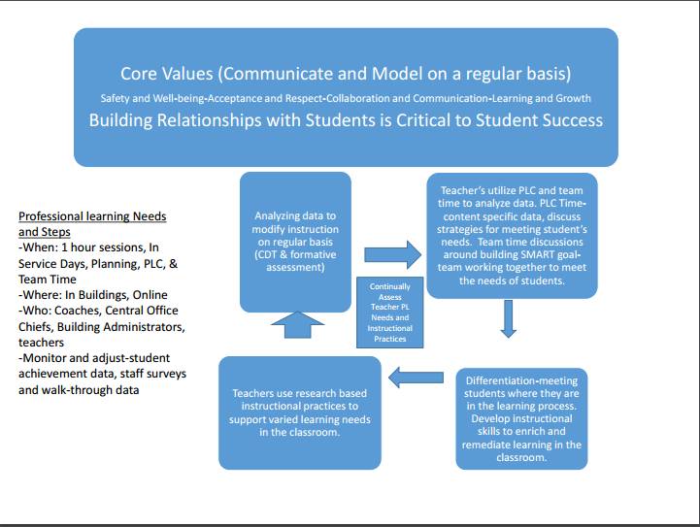
Theory of Change-Center around BASD Core Values

Slide 33
New/Revised Processes as a Result of POP Work
Flipped Classroom in 9th Grade Mathematics-Administrators directed teachers to use technology as a aide to collect data that would drive their instruction. Teachers researched, created, and implemented video lessons for a flipped classroom.
Workshop Approach in 7th Grade ELA Classes-Implemented in a double period of ELA class allows teachers to conference with small groups of students based on their individual needs.
Improved Flex Period Support-Regular scheduled time for each teacher to meet with selected students based on need.
  Tracking utilizing Google Form-measures type of interventions provided
Attendance Tracking-Identified potential truant students-Targeted families earlier to decrease student absences and provided additional support if necessary.

Slide 34
Theory of Change/Problem of Practice
Problem of Practice: To design teacher and principal learning that is grounded in day-to-day practice, personalized, and designed to enhance educators’ instructional practices with the intent of improving student learning.

Slide 35
2016-2017 Professional Learning Plans
Building | Topics
BASH | Team-building Constructed Responses Academy Learning and Development Special Education Link Crew Questioning and Rigor
MS | Team-building Cross-Curricular Integration Advisory FLEX Curriculum Development Differentiation/Small Group Instruction Questioning and Rigor

Slide 36
2016-2017 Professional Learning Plans
Building | Topics
Elementary Schools | Grade Level Collaboration (Questioning and rigor, examination of student work, lesson design, assessment protocols, differentiation)
 | Choice Sessions (Innovative practices, TDA, CRA, engagement strategies, technology integration, writing)

Slide 37
Questions?

